Slide 1
REST APIs, Frameworks, and Technology Stacks
Based on lecture notes from Dr. Chris Parnin and other resources.

Slide 2
This Week’s Topics
Web Basics (Tuesday)
REST API
Framework and Technology Slacks
Lab: REST API

Slide 3
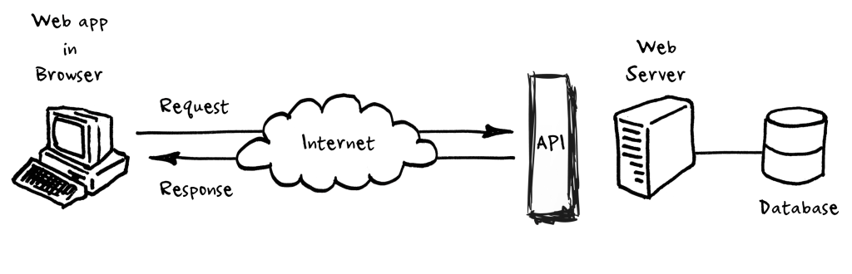
Client-Server Web Framework with API
Notes:
Most if not all applications nowadays follow client/server architecture. The App itself is a client or front end apart; underlying the hood, it needs to talk to the server or the back end, to get or save data. This communication happens using HTTP protocol, the same protocol that powers our web. On the server, exposes a bunch of services, accessible to the client via http protocol. The client can then directly call these services by sending http requests. This is where REST comes into the picture.

Slide 4
REST APIs – Background
REST = Representational State Transfer
describes an architectural style for web services (not a standard)
Software Architectural Style
Roy T. Fielding, “Architectural Styles and the Design of Network-based Software Architectures,” Ph.D Dissertation (2000). Chapter 5
Set of properties and constraints
Each API may be implemented in a slightly different way
Joshua Bloch – How to Design a Good API and Why it Matters
https://www.youtube.com/watch?v=aAb7hSCtvGw#t=2733
Notes:
REST: name does not make sense, due to PhD thesis work.

Slide 5
Why APIs?
Problem:
You want to expose a way for a client (who is a developer of some other system) to use your platform.
How do you define an abstract interface to your services?
API: Application Programming Interface
a messenger that takes requests and returns responses.
allows for interaction between applications, databases, and devices
E.g. if you want to
embed a map on your website, use Google's API
embed a tweet on your website, use Twitter's API
trade stocks in Python or R, use your broker's API
create 43 repositories named exam1-[github_name], use GitHub's API
There are thousands of APIs that exist. Most are integrated in a client-server framework.
Notes:
API: Application Programming Interface
a messenger that takes requests and returns responses.
allows for interaction between applications, databases, and devices

Slide 6
Example APIs
Facebook Graph API
https://developers.facebook.com/docs/graph-api
Twitter
https://dev.twitter.com/rest/public
Foursquare
https://developer.foursquare.com/
Salesforce – Force API
https://developer.salesforce.com/page/REST_API
Twilio
https://www.twilio.com/docs/api/rest

Slide 7
API General Principles (1)
Do one thing well
You can never remove
If it’s hard to name, that’s a bad sign
Implementation should not impact API
Don’t “leak” implementation details
Façade pattern
Minimize accessibility of EVERYTHING
Information hiding
Modules used independently
Notes:
Façade pattern: Analogous to a facade in architecture, a facade is an object that serves as a front-facing interface masking more complex underlying or structural code.

Slide 8
API General Principles (2)
Names Matter
Names should be self-explanatory
Consistent naming – words mean the same
Don’t make the client do something the API could easily do
Reduce need for boilerplate code
Notes:
In computer programming, boilerplate code or just boilerplate refers to sections of code that have to be included in many places with little or no alteration. It is often used when referring to languages that are considered verbose, i.e. the programmer must write a lot of code to do minimal jobs.

Slide 9
RESTful APIs
Architectural Properties
Performance – appropriate component interactions
Scalability – support large numbers of components and interactions among components
Simplicity of interfaces
Modifiability of components
Visibility of communication between components by service agents
Portability of components by moving program code with the data
Reliability when failures within components, connectors, or data
Wikipedia

Slide 10
RESTful APIs
Architectural Constraints
Client-server
Stateless
Cacheable
Layered system
Code on demand (optional)
Uniform Interface
Identification of resources
Manipulation of resources through these representations
Self-descriptive messages
Hypermedia as the engine of application state (HATEOAS)
Client-server: separation of concerns
Clients – not concerned with data storage – allows for portability
Servers – not concerned with the UI or user state – allows for scalability
Clients and servers switched out as long as interface is maintained
{
“name”: “John Doe”,
“self”: “http://localhost:8080/users/123",
“posts”: “http://localhost:8080/users/123",
“address”: “http://localhost:8080/users/123/address"
}
Wikipedia
Notes:
Client-server: separation of concerns
Clients – not concerned with data storage – allows for portability
Servers – not concerned with the UI or user state – allows for scalability
Clients and servers switched out as long as interface is maintained
Stateless
No client context is stored on the server requests
Client sends all context necessary for server to process request.
Session state held in client
Request made when client is ready to change state
Cacheable
Clients can cache response. Responses must defined themselves as cacheable or not to prevent clients from reusing stale or inappropriate data in response to further requests. Well managed caching improves scalability and performance
Layered system
Client cannot tell if connected directly to end server or intermediary
Intermediary may allow for scalability (load balancing and shared caches). Enforce security policy.
Code on demand – could transfer executable code (client side scripts like JavaScript)
Uniform interface
Fundamental
Identification of resources – identified in requests by using URIs
Resources conceptually separate from the representations that are returned to the client (HTML, XML, JSON)
Manipulation of resources through these representations – client has enough info to modify or delete the resource when it has a representation
Self-descriptive messages – enough info to describe how to process the message (define the appropriate parser, cacheability)
Hypermedia as the engine of application state (HATEOAS) – clients make state transitions only through actions that are dynamically identified within hypermedia by the server. Client does not assume that any particular action is available for any particular resources beyond those described in representation s previous received from the server.

Slide 11
Pragmatic REST API Design
Audience: developer
Goal: Make developer as successful as possible
Nouns = Resources (top level object)
Collections (plurals)
Element of collection(Singulars)
Verbs = Operations on collections and element
Use HTTP Verbs to define actions
POST (create)
GET (read)
PUT (update)
DELETE (delete)
/dogs
/dogs/1234
Web API Design
Notes:
A RESTful API service is exposed through a Uniform Resource Locator (URL)

Slide 12
Example REST API Interactions
Resource | POST (create) | GET (read) | PUT (update) | DELETE (delete)
/dogs | Create a new dog | List dogs | Bulk update dogs | Delete all dogs
/dogs/1234 | Error | Show Bo | If exists, update Bo If not, error | Delete Bo
Web API Design - Table from Page 7

Slide 13
Resource Associations (Hierarchy)
Handling associations adds another level to the URL
Once have primary key for one level (an element) you don’t need to include levels above it
Pattern
Example: Dogs have owners
Get all the dogs for an owner
Create a new dog for an owner
/resource/identifier/resource
GET /owners/5678/dogs
POST /owners/5678/dogs
Web API Design

Slide 14
Parameters: States and Attributes
States and resource attributes shouldn’t be handled as associations
Add them behind the HTTP question mark
GET /dogs?color=red&state=running&location=park
Web API Design

Slide 15
Handling Errors
Errors provide context to client misuse of the black-box behind the API
Use HTTP status codes
2xx Success: Everything worked
200 - OK
4xx Client Errors: The application did something wrong
400 – Bad Request
401 – Unauthorized
403 Forbidden
404 Not Found
5xx Server Errors: The API did something wrong
500 – Internal Server Error
Add additional codes as appropriate
Returned messages should be verbose
Web API Design

Slide 16
Other Considerations
Versioning – APIs should be versioned
Make version mandatory in URL/header
Pagination
Provide way to limit number of responses
Offset and limit
Partial Response
Let clients request a subset of information about a resource
Authentication – Use common libraries (OAuth)
Web API Design

Slide 17
Responses without Resources
Goes back to making sure that you aren’t making your client do things the API could do
Common actions
Use verbs
Clearly define actions vs. resources in documentation
Consistency matters
Search
Global
Scoped
/convert?from=EUR&to=CNY&amount=100
/search?q=fluffy+fur
/owners/5678/dogs?q=fluffy+fur
Web API Design

Slide 18
Response Formats
XML (Extensible Markup Language)
Store and transport data
Schema defines the tags that describe the data
Libraries to help with binding XML to objects (JAXB)
JSON (JavaScript Object Notation)
Lightweight data-interchange format
Collection of name/value pairs (object)
Ordered list of values (array)
var myObject = JSON.parse(response);
W3Schools – XML and JSON.org
Notes:
Allow multiple formats
Format could be specified in the header or as part of the URL

Slide 19
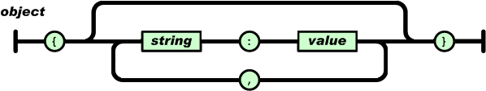
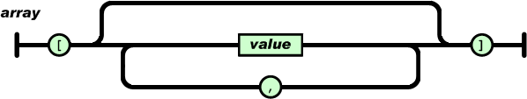
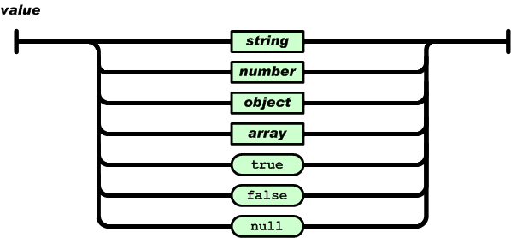
JSON Structures
Object
Array
Value
JSON.org

Slide 20
APIs and SDKs
APIs may be complimented with SDKs
Supplies the domain knowledge for the client side
Web API Design

Slide 21
Example: Open Brewery DB
Open Brewery DB APIs:
https://www.openbrewerydb.org/documentation
Explore each of the endpoints
Try some example HTTP requests
Questions:
Can you get a list of brewery in the city of “Raleigh” and the state of “North Carolina”?

Slide 22
Frameworks
Frameworks are domain-specific design made up of a collection of abstract and concrete classes and the interfaces between them.
The sub-system is implemented by adding components to fill in parts of the design (“hot-spots”) and by instantiating the abstract classes in the framework.

Slide 23
Types of Frameworks
A white-box framework requires understanding the internals of the framework. Behavior is extended by creating subclasses, taking advantage of inheritance. Think Photoshop.
A black-box framework does not require a deep understanding of the framework’s implementation. Behavior is extended by composing objects together, and delegating behavior between objects. Think Instagram.

Slide 24
Designing a Framework
Rule of three:
Take 3 applications in same domain.
Refactor duplicated code into common components.
Identify common concepts and abstract as framework.
http://blog.codinghorror.com/rule-of-three/

Slide 25
Issues with Frameworks
Development effort
Learning curve
Integratability
Maintainability
Politics
Notes:
Development effort -- While developing complex software is hard enough, developing high quality, extensible, and reusable frameworks for complex application domains is even harder. The skills required to produce frameworks successfully often remain locked in the heads of expert developers. One of the goals of this theme issue is to demystify the software process and design principles associated with developing and using frameworks.
Learning curve -- Learning to use an OO application framework effectively requires considerable investment of effort. For instance, it often takes 6-12 months become highly productive with a GUI framework like MFC or MacApp, depending on the experience of developers. Typically, hands-on mentoring and training courses are required to teach application developers how to use the framework effectively. Unless the effort required to learn the framework can be amortized over many projects, this investment may not be cost effective. Moreover, the suitability of a framework for a particular application may not be apparent until the learning curve has flattened.
Integratability -- Application development will be increasingly based on the integration of multiple frameworks (e.g. GUIs, communication systems, databases, etc.) together with class libraries, legacy systems, and existing components. However, many earlier generation frameworks were designed for internal extension rather than for integration with other frameworks developed externally. Integration problems arise at several levels of abstraction, ranging from documentation issues [Fayad-Hamu 97], to the concurrency/distribution architecture, to the event dispatching model. For instance, while inversion of control is an essential feature of a framework, integrating frameworks whose event loops are not designed to interoperate with other frameworks is hard.
Maintainability -- Application requirements change frequently. Therefore, the requirements of frameworks often change, as well. As frameworks invariably evolve, the applications that use them must evolve with them.

Slide 26
Dependency Injection Frameworks
Separates creation of a clients’ dependencies from the client’s behaviors
Loosely coupled program
Dependency inversion and single responsibility principals
Injection – similar to parameter passing
Isolates client from the details
Wikipedia – Dependency Injection

Slide 27
Dependency Injection Roles
Service object(s): any object that can be used
Client object: any object that uses other objects
Interfaces: how a client may use the services
Never treated as concrete – no construction or extension by client
Injector: constructs the services and injects them into the client
Introduces the services into the client, maybe by constructing the client.
Wikipedia – Dependency Injection

Slide 28
Dependency Injection Pros & Cons
Pros
Configurable and isolated client
Configurations in external files (annotations also possible)
Changes without recompilation
Different configurations for different scenarios (testing)
Cons
Clients demand config details in construction code
Hard to trace code
Explosion of types
Complexity moved to links between classes
Wikipedia – Dependency Injection

Slide 29
Example DI Frameworks
Spring
Guice
Play Framework
HK2 Dependency Injection Kernel (Glassfish)

Slide 30
Object-Relational Mapping (ORM)
A framework for representing and interacting with database entities
Common Frameworks
Hibernate
EJB – Enterprise Java Beans
OpenJPA (Apache)
Principles
Code-first
Database-first
Annotations/Configurations
Query-based

Slide 31
Technology Stacks
Collection of APIs, frameworks, and COTS that spans a software system’s architecture
Common Stacks
LAMP – Linux, Apache HTTPD, MySQL, PHP
Microsoft – Windows, IIS, SQL Server, Entity Framework, .NET
Hipster – Heroku, mongre, MongoDB, Ruby on Rails
MEAN – MongoDB, Express, Angular.js, Node.js

Slide 32
Common Components
Operating System
Server
Database
Object-Relational Mapping
Cluster/Caching/Routing
Back-end Languages
Front-end Languages
Notes:
Routing Frameworks – map resource requests to code actions
Examples: Ninja, Express, Nancy

Slide 33
Technology Stack Issues
Choosing a technology stack is hard.
Technology and devs “Playing nice”.
Multiple languages. Many moving parts.

Slide 34
References
R. T. Fielding, “Architectural Styles and the Design of Network-based Software Architectures,” Ph.D. Dissertation, University of California, Irvine, 2000.
https://www.ics.uci.edu/~fielding/pubs/dissertation/fielding_dissertation.pdf
T. Fredrich, “Learn REST: A RESTful Tutorial,” http://www.restapitutorial.com/
B. Mulloy, “Web API Design,” Apigee. https://pages.apigee.com/rs/apigee/images/api-design-ebook-2012-03.pdf
Wikipedia
“Representation State Transfer”. Last modified 10/27/2015 at 23:06. https://en.wikipedia.org/wiki/Representational_state_transfer
“Dependency Injection”. Last modified 10/22/2015 at 12:39. https://en.wikipedia.org/wiki/Dependency_injection

Slide 35
REST API Lab
See instructions on CANVAS.

